Slide 1

EndNote X9 advanced tutorial

Slide 2
Outline
Welcome to the Clarivate EndNote X8.2 introduction. This document provides a common reference management framework for all academic researchers and normal students.
Here is what we want to tell you about EndNote X8. EndNote X9 has been released for a month, we did not get the authority version, so we only introduce X8 version. Please searching the user manuals for more details.
The installation guide
What EndNote can do and several statements you may use often
Professional introduction
file structure
Library Sync,
Online Search Mode Introduction
PDF expert Sync with Nutstore WebDAV protocol

Slide 3
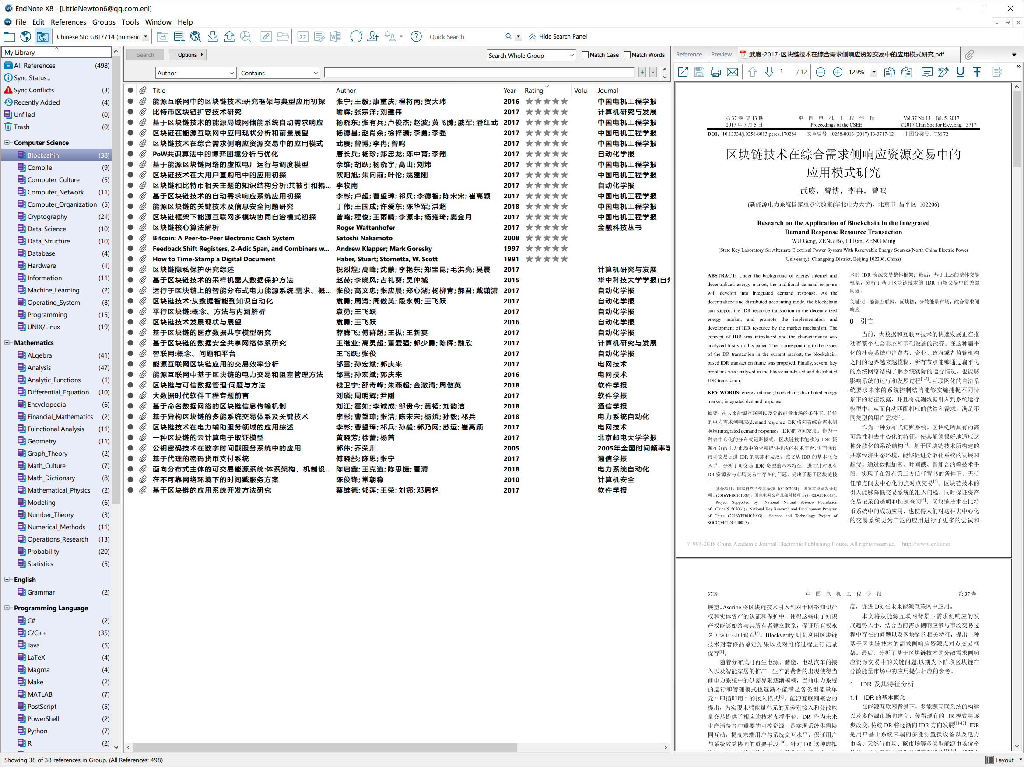
Installation guide
Windows 10 1803
macOS Mojave
iOS for iPad or iPad Pro

Slide 4
Installation guide
Windows 10 1803
macOS Mojave
iOS for iPad or iPad Pro

Slide 5
What EndNote can do
Manage your reference Library
Work together with Microsoft Word or LaTeX to insert and manage citations
Share your library to your friends or tutor

Slide 6
What EndNote can do
Several annoying statements
In these situations, you may feels very annoyed for the software is not so smart. Do they really NOT SMART, or just you don’t know how to use them?
Writing Microsoft Word files
if I want to insert a new citation between two old ones
if I want to delete a citation which has already exist in the paper
if I want to change the citation style
if the citation needed to be edited and updated
Oh my God…
Manage the references
There are so many independent PDFs in my file system
I am going to write a new paper but I still need to cite several references which have been used in an old paper, should I need to reinput them?
Now I don’t know what these paper mainly talk about because I don’t want to open them to read the abstract one by one
Manage your reference Library
Work together with Microsoft Word or LaTeX to insert and manage citations
Share your library to your friends or tutor

Slide 7
What EndNote can do
Manage your reference Library
Work together with Microsoft Word or LaTeX to insert and manage citations
Share your library to your friends or tutor

Slide 8
Three User Mode
User Mode is a specific mode to control this software. Different mode has different highlights, but sometimes they look the same.
EndNote X8 provides three typical user modes which are usually used during writing and searching.
Local Library Mode, the most frequently used user mode. It is based on a local library folder and a .enl file and both the two has the same name
Online Search Mode (Temporary Library), in this mode, you can search the references you needed with several keywords, such as the Author Name, Year, Journal, etc. The searching result can be imported into this Temporary Library, which means after you restarting EndNote, this library would be empty automatically. Remember to store the research result before closing EndNote.
Integrated Library and Online Search Mode: Local Library Mode addition with an online search mode.
Local Library Mode
Online Search Mode (Temporary Library)
Integrated Library and Online Search Mode

